Slide 1





NATHAN GABRIEL C. DANAC
MAY 21, 2024
Predicting Formula 1 Race Results using Machine Learning
App Physics 157 Final Project

Slide 2
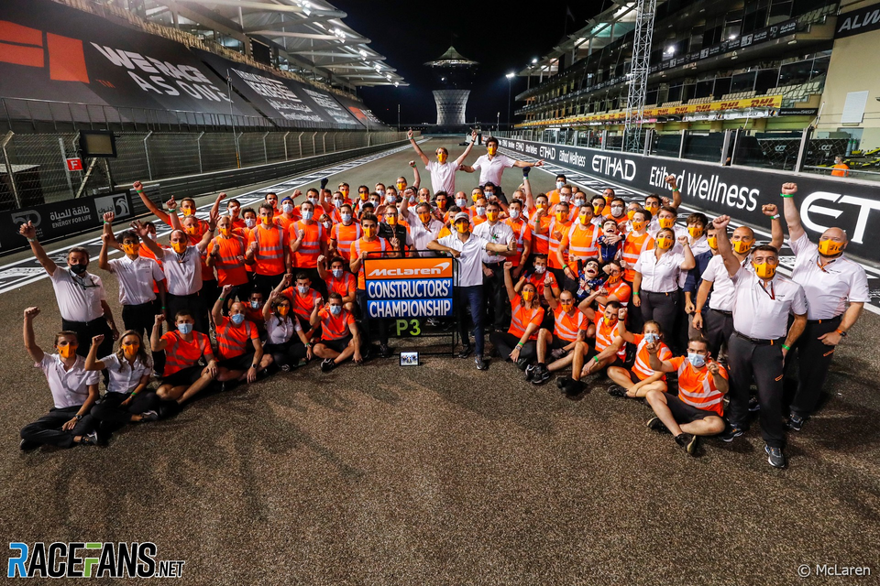
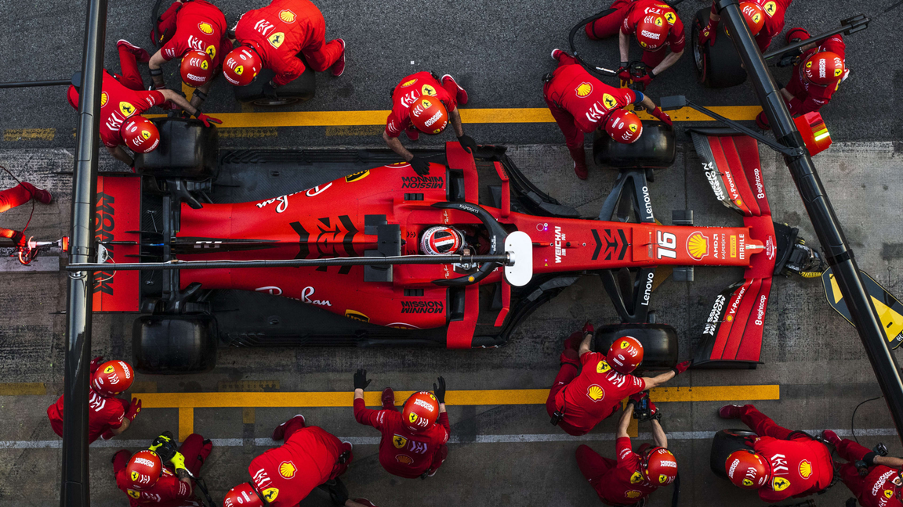
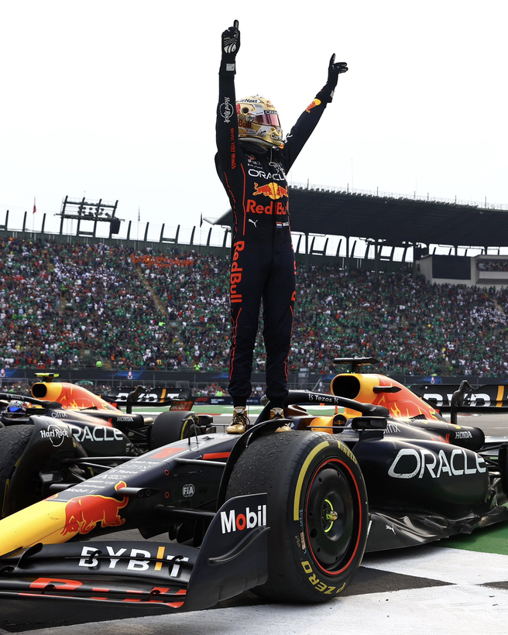
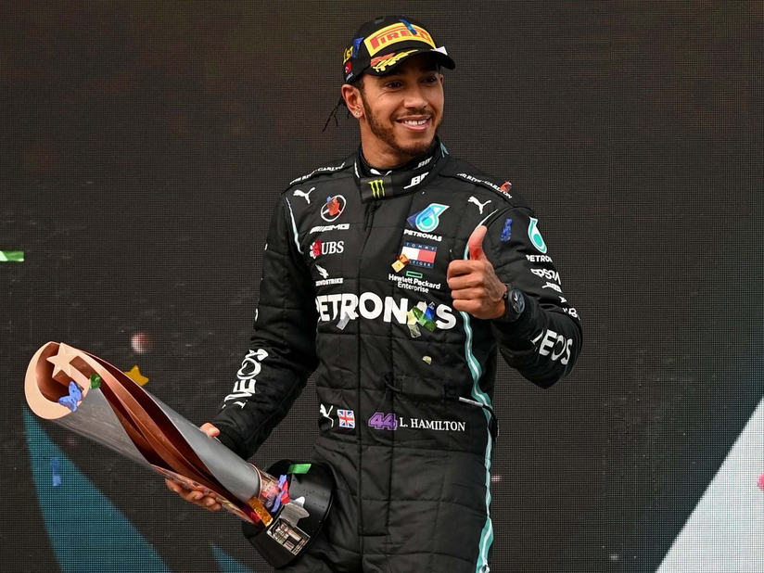
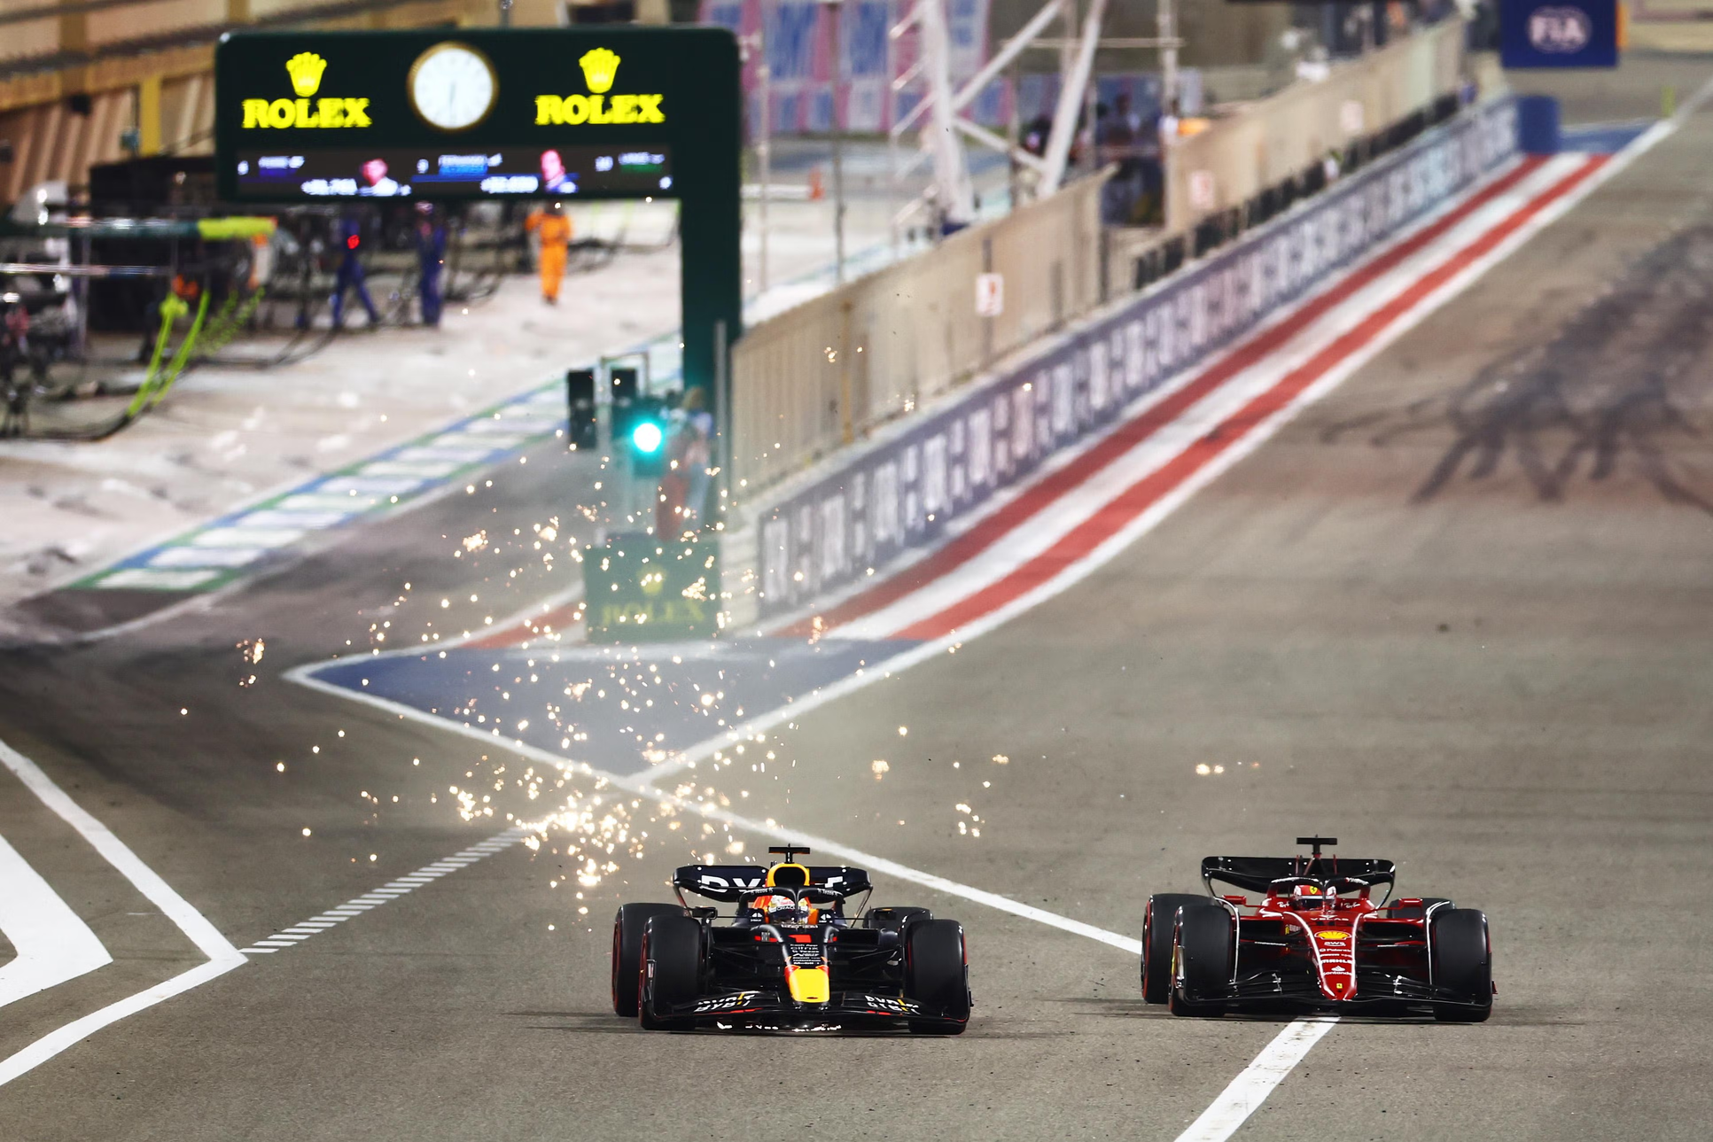
DANAC - Prediciting F1 Results using ML
Formula 1
considered the “pinnacle of motorsport”
each team (constructor) designs their own car from scratch, adhering to a strict set of regulations
each team consists of two drivers and 250 to 1,200 staff
a large portion of the team stays at the factory
responsible for car development and race strategy
2
Notes:
F1 cars are a marvel of engineering and my personal reason for pursuing physics.
A large portion of the team stays at their home factory, and is instead responsible for crunching the numbers and optimizing the

Slide 3
DANAC - Prediciting F1 Results using ML
Why Machine Learning?
there are many factors to consider in predicting a race
car performance
driver performance
weather
tyre wear
fuel load
etc.
creating a quantitative model can be exhausting
by representing these parameters in a dataset, we can use ML to predict race results
3

Slide 4
DANAC - Prediciting F1 Results using ML
2022 Season
22 Grands Prix
Each Grand Prix consists of:
3 Free Practice sessions (FP1-FP3)
3 Qualifying sessions (Q1-Q3)
1 Race proper
20 drivers, 10 teams
4
Notes:
F1 cars are a marvel of engineering and my personal reason for pursuing physics.
A large portion of the team stays at their home factory, and is instead responsible for crunching the numbers and optimizing the

Slide 5
DANAC - Prediciting F1 Results using ML
2022 Formula 1 Season Dataset (Kaggle)
contains the results for each session of each Grand Prix (e.g. 2022 Bahrain GP)
Driver Name (“Charles Leclerc”)
Car (“Ferrari”)
Racing # (16)
Laps Completed (57)
Time(s) (1:37:33.584)
Starting Position (P1)
Placement (P1)
Points Scored (25)
imported and processed using pandas
5

Slide 6
DANAC - Prediciting F1 Results using ML
Data Pre-Processing
re-formatted all data points:
Driver Name (“Charles Leclerc”) -> driver_id (based on their final drivers’ championship placement)
Car (“Ferrari”) -> constructor_id (based on their final constructors’ championship placement)
Racing # (16)
Laps Completed (57)
Time(s) (1:37:33.584) -> [session]_time (converted into seconds)
Starting Position (P1) -> grid (number only)
Placement (P1) -> [session] (number only)
Points Scored (25)
round (round #)
6

Slide 7
DANAC - Prediciting F1 Results using ML
Data Pre-Processing
data was missing for some sessions
all NaNs or incomplete data was replaced with the average of the data points for that session (e.g. if FP1 time for “Alex Albon” was NaN, it was replaced by the mean FP1 time of all drivers)
The race result was selected as the class for our model, while all the times and placements from the other sessions were selected as the features
“What position will you finish in the race given your performance and placements from all the sessions from each Grand Prix throughout the season?”
The rounds throughout the season were partitioned as follows:
1-16 (training)
17-19 (cross-validation)
20-22 (testing)
7

Slide 8
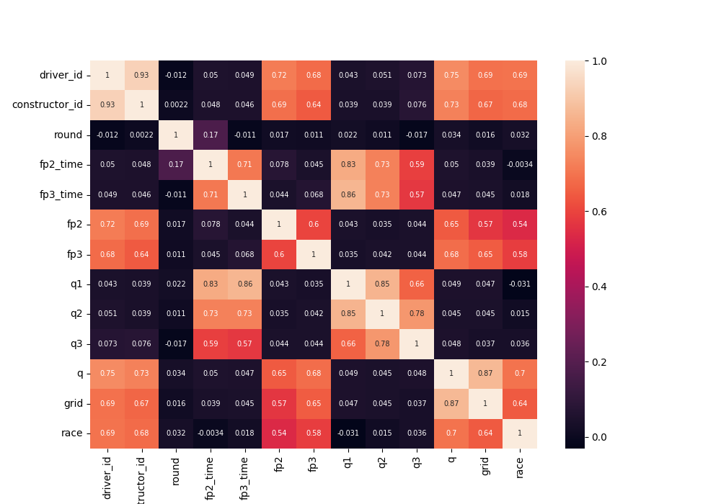
DANAC - Prediciting F1 Results using ML
Correlation
8

Slide 9
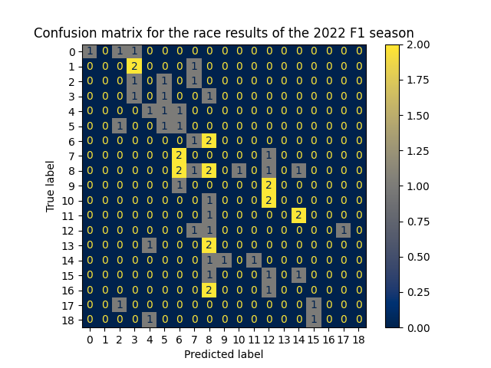
DANAC - Prediciting F1 Results using ML
Decision
Tree
Classifier
sklearn.tree
accuracy = 10.00%
was able to predict (P1, P4, P5, P6, P8)
9

Slide 10
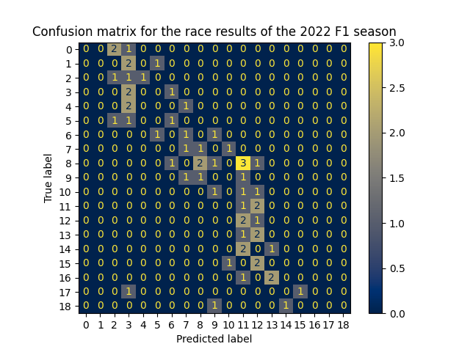
DANAC - Prediciting F1 Results using ML
Random Forest
Regressor
sklearn.ensemble
accuracy = 13.33%
predicted result is within a certain range of the true result
10

Slide 11
DANAC - Prediciting F1 Results using ML
Conclusions
F1 race results can be predicted from data from other sessions throughout the season
The Random Forest Regressor model provided more accurate results compared to the Decision Tree Classifier model
The model’s predicted race result usually falls within a certain range of the true race result.
As a proof-of-concept, I’m happy with the project :-)
Future Improvements
The scope of the data can be widened (e.g. historic data from previous seasons)
We can potentially consider race result in intervals rather than per position
(e.g. classes = [”P1-3", “P4-10”, “P11-20”]
The learning of the model can be further supervised
(e.g. for each race, only 1 driver must be predicted for each class, since there are no ties)
11

Slide 12


Thanks For Listening!
:-)

